Slide 1
2d photonic crystals
Steven G. Johnson, MIT
18.369/8.315, Spring 2018
See also chapters 5 and 10 of Photonic Crystals: Molding the Flow of Light

Slide 2
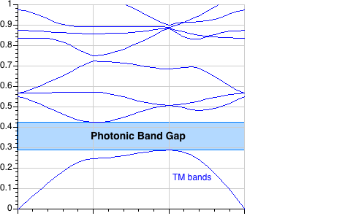
2d periodicity, ε=12:1
a
Frequency ω (2πc/a) = a / λ
irreducible Brillouin zone
Γ
X
M
Γ
M
k
E
TM
gap for
n > ~1.75:1
Γ
X
H

Slide 3
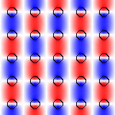
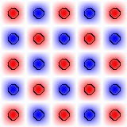
2d periodicity, ε=12:1
E_{z}
(+ 90° rotated version)
E_{z}
Γ
X
M
Γ
E
gap for
n > ~1.75:1
TM
–
+
H

Slide 4
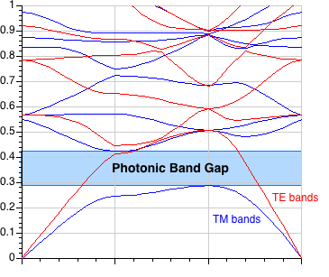
2d periodicity, ε=12:1
a
frequency ω (2πc/a) = a / λ
irreducible Brillouin zone
Γ
X
M
Γ
M
k
E
E
X
TM
TE
Γ
H
H

Slide 5
What a difference a boundary condition makes…
ε₁
ε₂
E|| is continuous:
energy density ε|E|²
more in larger ε
E_{1,||} = E_{2,||}
εE⊥ is continuous:
energy density |εE|²/ε
more in smaller ε
ε₁E_{1,⊥} = ε₂E_{2,⊥}
To get strong confinement & gaps,
want E mostly parallel to interfaces
TM: ||
TE: ⊥

Slide 6
2d photonic crystal: TE gap, ε=12:1
TE bands
TM bands
E
TE
H
gap for n > ~1.4:1

Slide 7
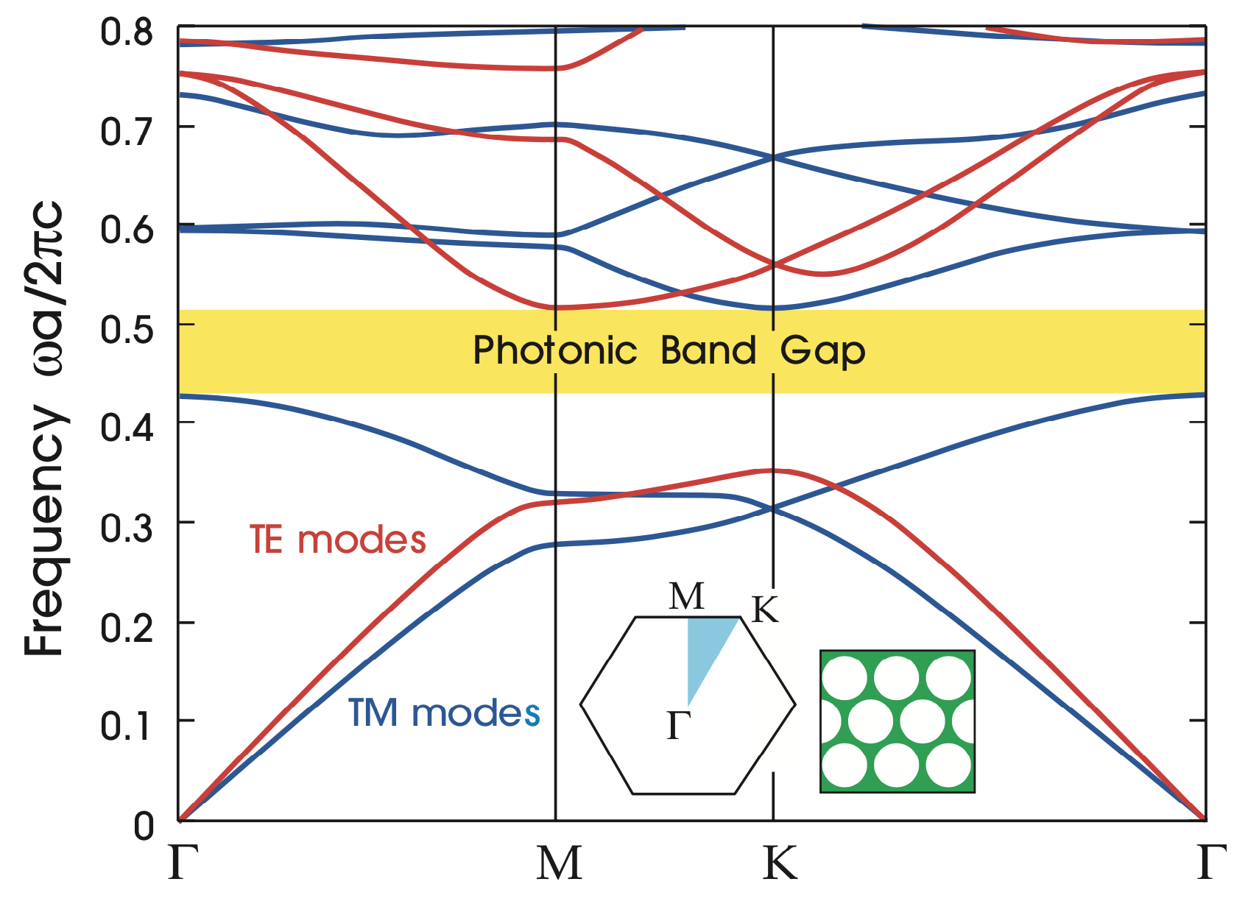
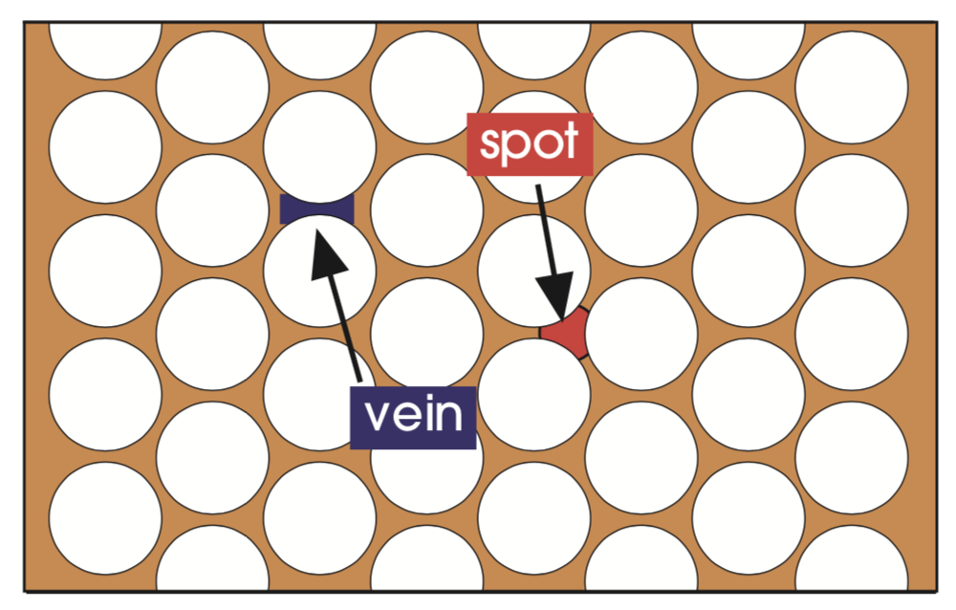
“Complete” (TE+TM) gap in 2d
Spots: big enough for lowest TM bands
to concentrate (gap with 3rd band)
Veins: lowest TE band circles around holes

Slide 8
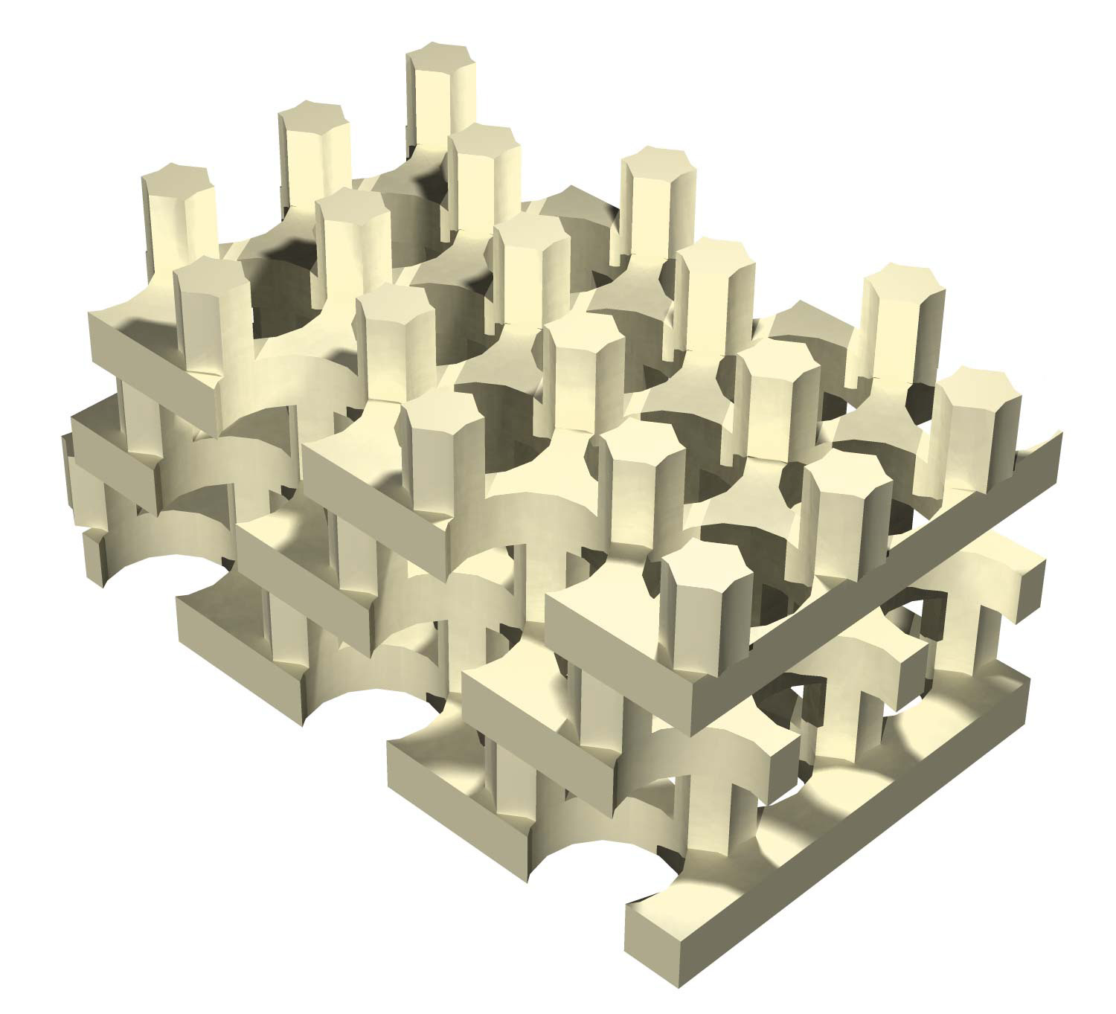
3d photonic crystal: complete gap , ε=12:1
I.
II.
gap for n > ~2:1
[ S. G. Johnson et al., Appl. Phys. Lett. 77, 3490 (2000) ]

Slide 9
Intentional “defects” are good
microcavities
waveguides (“wires”)

Slide 10
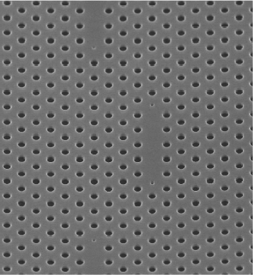
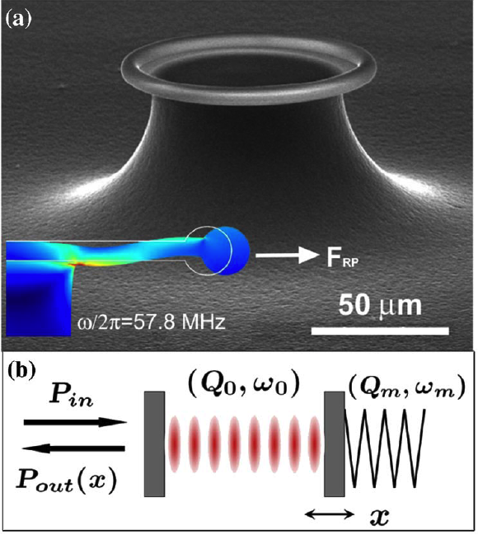
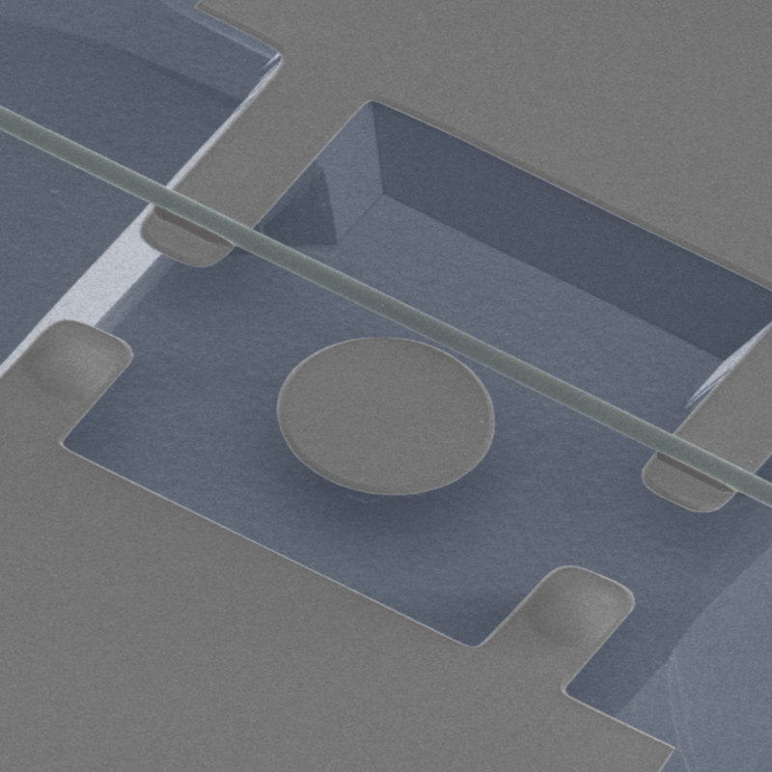
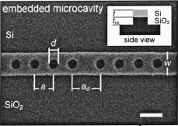
Resonance
an oscillating mode trapped for a long time in some volume
(of light, sound, …)
frequency ω₀
lifetime τ >> 2π/ω₀
quality factor Q = ω₀τ/2
energy ~ e^{–ω0t/Q}
modal
volume V
[ Notomi et al. (2005). ]
[ C.-W. Wong,
APL 84, 1242 (2004). ]
[ Schliesser et al.,
PRL 97, 243905 (2006) ]
420 nm
[ Eichenfield et al. Nature Photonics 1, 416 (2007) ]

Slide 11
Why Resonance?
an oscillating mode trapped for a long time in some volume
• long time = narrow bandwidth … filters (WDM, etc.)
— 1/Q = fractional bandwidth
• resonant processes allow one to “impedance match”
hard-to-couple inputs/outputs
• long time, small V … enhanced wave/matter interaction
— lasers, nonlinear optics, opto-mechanical coupling,
sensors, LEDs, thermal sources, …

Slide 12
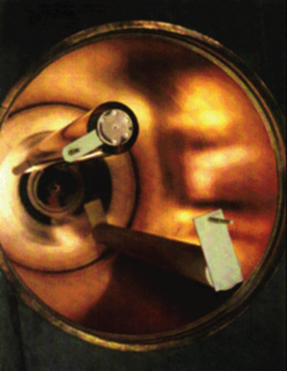
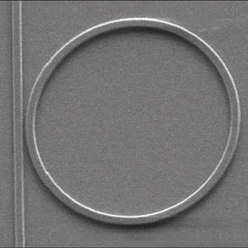
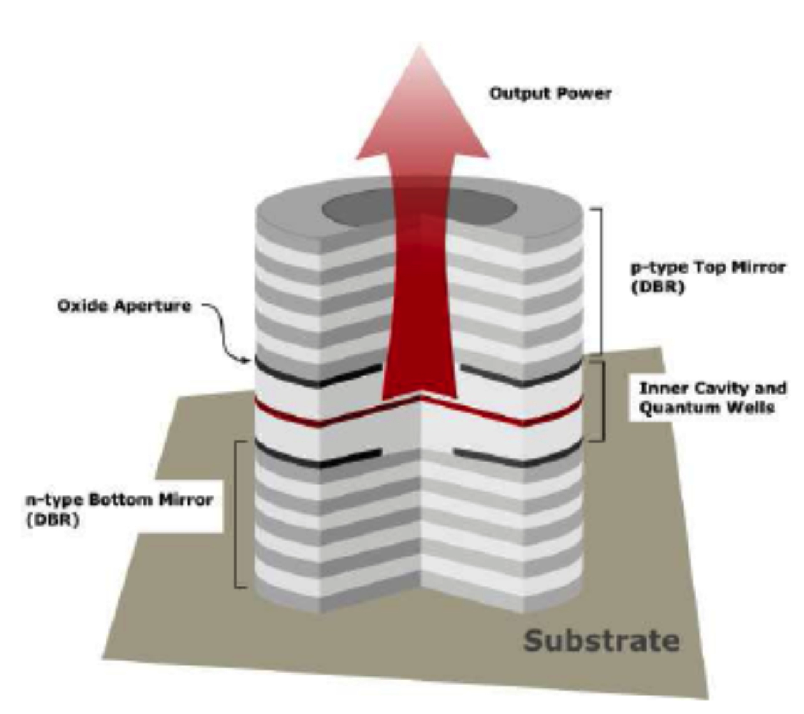
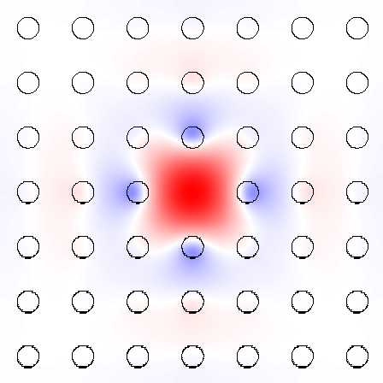
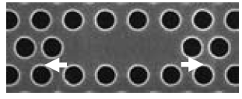
How Resonance?
need mechanism to trap light for long time
metallic cavities:
good for microwave,
dissipative for infrared
[ Xu & Lipson
(2005) ]
10µm
VCSEL
[fotonik.dtu.dk]
ring/disc/sphere resonators:
a waveguide bent in circle,
bending loss ~ exp(–radius)
[ llnl.gov ]
[ Akahane, Nature 425, 944 (2003) ]
photonic bandgaps
(complete or partial
+ index-guiding)
(planar Si slab)

Slide 13
Why do defects in crystals trap resonant modes? What do the modes look like?

Slide 14
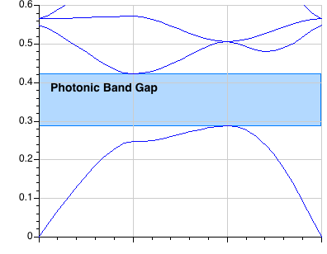
Single-Mode Cavity
Bulk Crystal Band Diagram
frequency (c/a)
A point defect
can push up
a single mode
from the band edge
Γ
X
M
Γ
M
X
(k not conserved)
Γ

Slide 15
“Single”-Mode Cavity
Bulk Crystal Band Diagram
frequency (c/a)
A point defect
can pull down
a “single” mode
…here, doubly-degenerate
(two states at same ω)
Γ
X
M
Γ
X
M
X
(k not conserved)
Γ

Slide 16
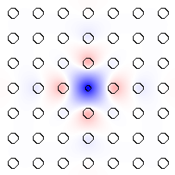
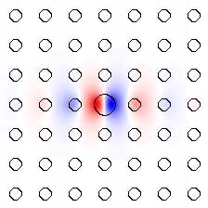
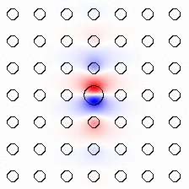
Tunable Cavity Modes
frequency (c/a)
E_{z}:
monopole
dipole

Slide 17
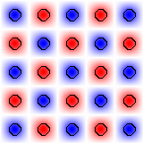
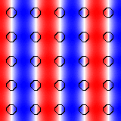
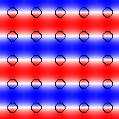
Tunable Cavity Modes
band #1 at M
band #2 at X’s
multiply by exponential decay
E_{z}:
monopole
dipole

Slide 18
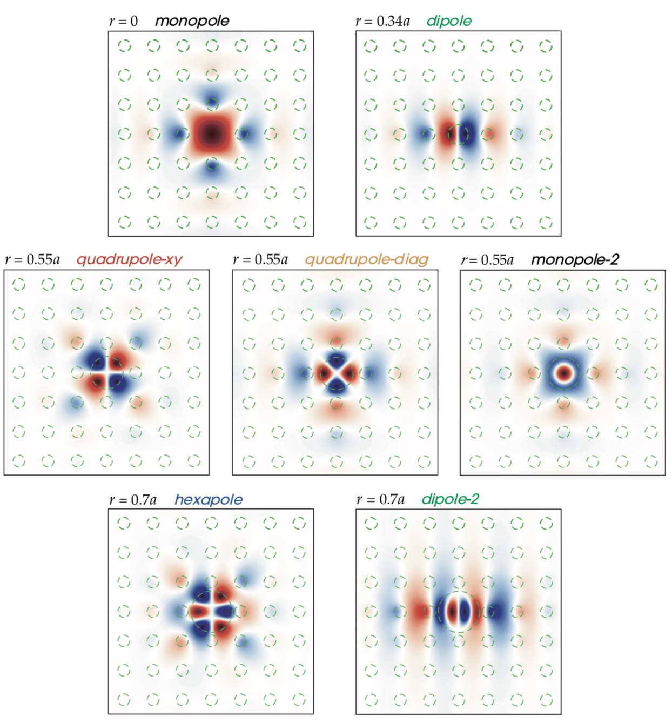
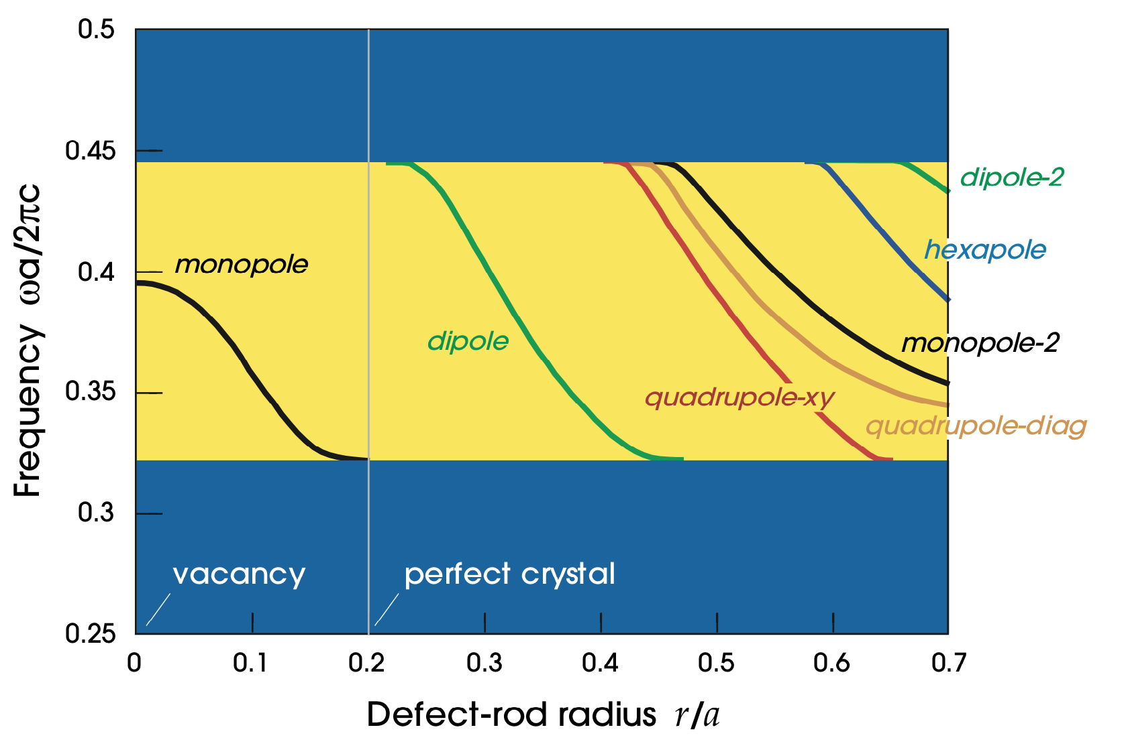
More defect modes (4 out of 5 C_{4v} irreps here)

Slide 19
Intentional “defects” are good
microcavities
waveguides (“wires”)

Slide 20
Projected Band Diagrams
1d periodicity
M
X
not conserved
Γ
conserved k!
conserved
So, plot ω vs. k_{x} only…project Brillouin zone onto Γ–X:
gives continuum of bulk states + discrete guided band(s)

Slide 21
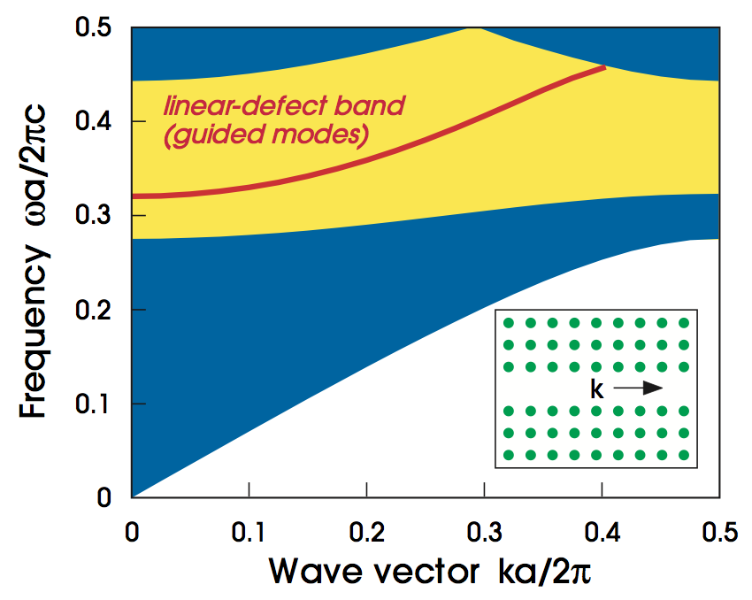
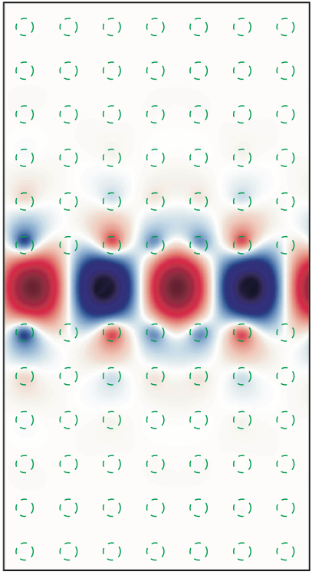
Air-waveguide Band Diagram
continuum of
bulk-crystal modes
any state in the gap cannot couple to bulk crystal ⇒ localized

Slide 22
(Waveguides don’t really need a complete gap)
Fabry-Perot waveguide:
This is exploited e.g. for photonic-crystal fibers…

Slide 23
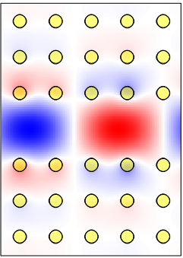
Guiding Light in Air!
mechanism is gap only
vs. standard optical fiber:
“total internal reflection”
— requires higher-index core
no hollow core!
hollow = lower absorption, lower nonlinearities, higher power

Slide 24
Review: Why no scattering?
forbidden by Bloch
(k conserved)
forbidden by gap
(except for finite-crystal tunneling)

Slide 25
Benefits of a complete gap…
broken symmetry –> reflections only
effectively one-dimensional

Slide 26
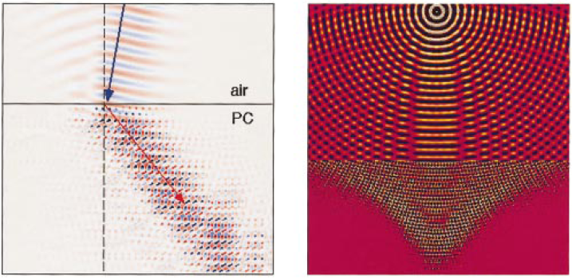
Band diagrams: Poor tool to understand refraction/reflection at interfaces
Frequency ω (2πc/a) = a / λ
[ M. Notomi, PRB 62, 10696 (2000). ]
Γ
X
M
Γ
At an interface, only ω and surface-parallel k are conserved.
— we need all the solutions at a given ω, not the different ω’s at a given k.

Slide 27
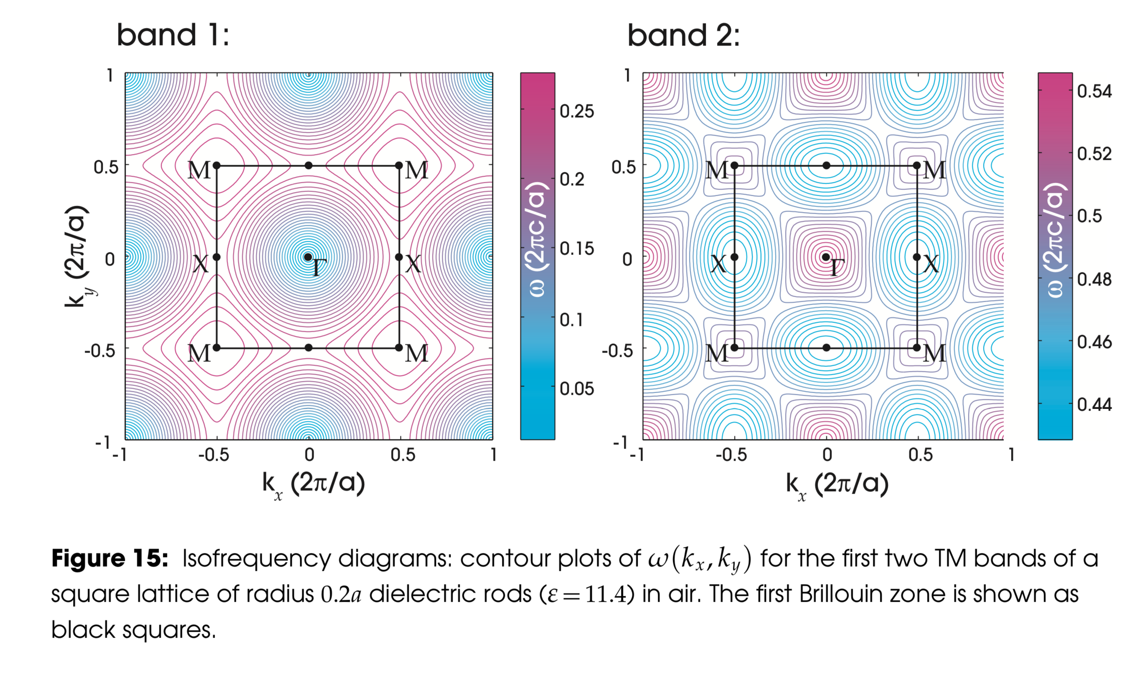
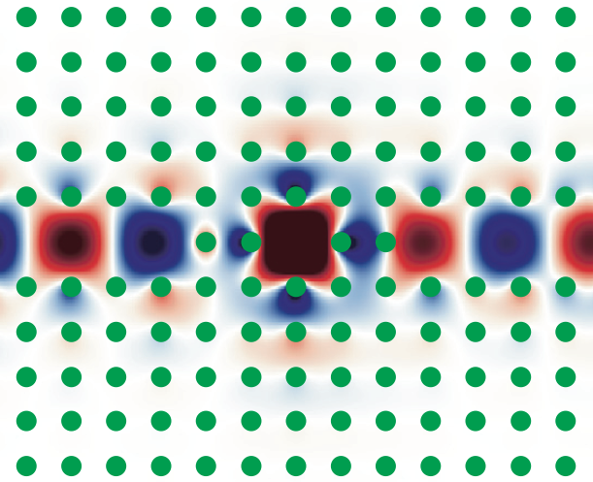
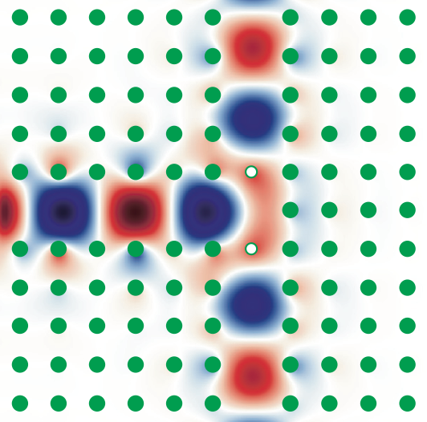
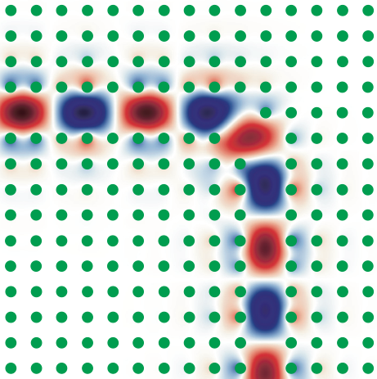
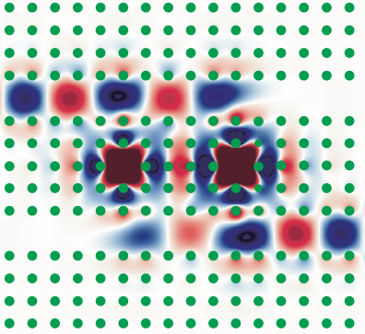
“1d” Waveguides + Cavities = Devices
resonant filters
waveguide splitters
high-transmission
sharp bends
channel-drop filters

Slide 28
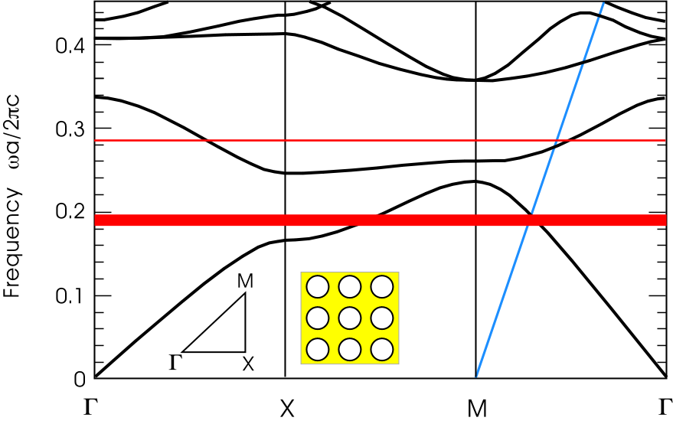
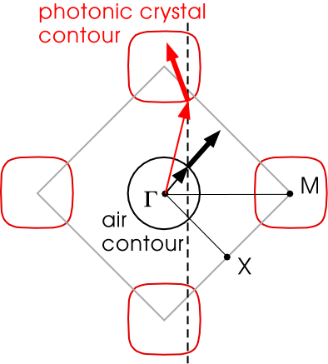
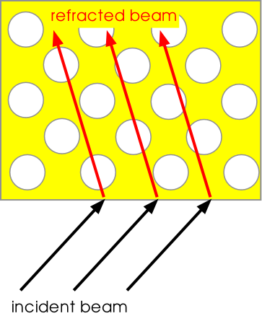
Refraction and wavevector diagrams
[ Luo et al, PRB 65, 2001104 (2002). ]
ω contours
in (k_{x},k_{y}) space
k|| is conserved

Slide 29
Negative-refractive all-dielectric photonic crystals
negative refraction
focussing
(2d rods in air, TE)
[ M. Notomi, PRB 62, 10696 (2000). ]
not metamaterials: wavelength ~ a,
no homogeneous material can reproduce all behaviors

Slide 30
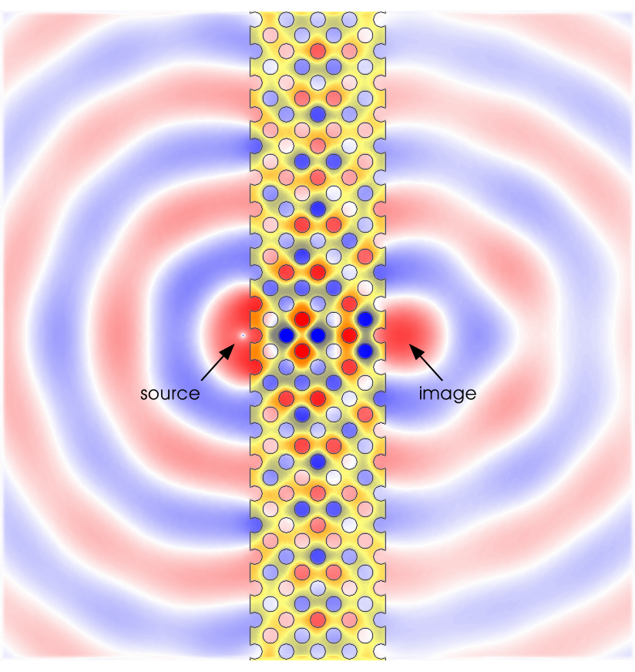
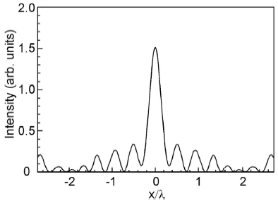
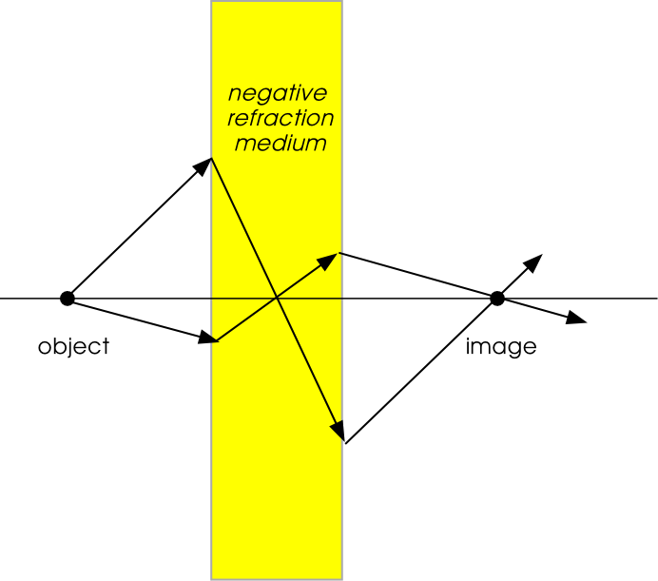
“Superlensing” with Photonic Crystals
[ Luo et al, PRB 68, 045115 (2003). ]
2/3 diffraction limit

Slide 31
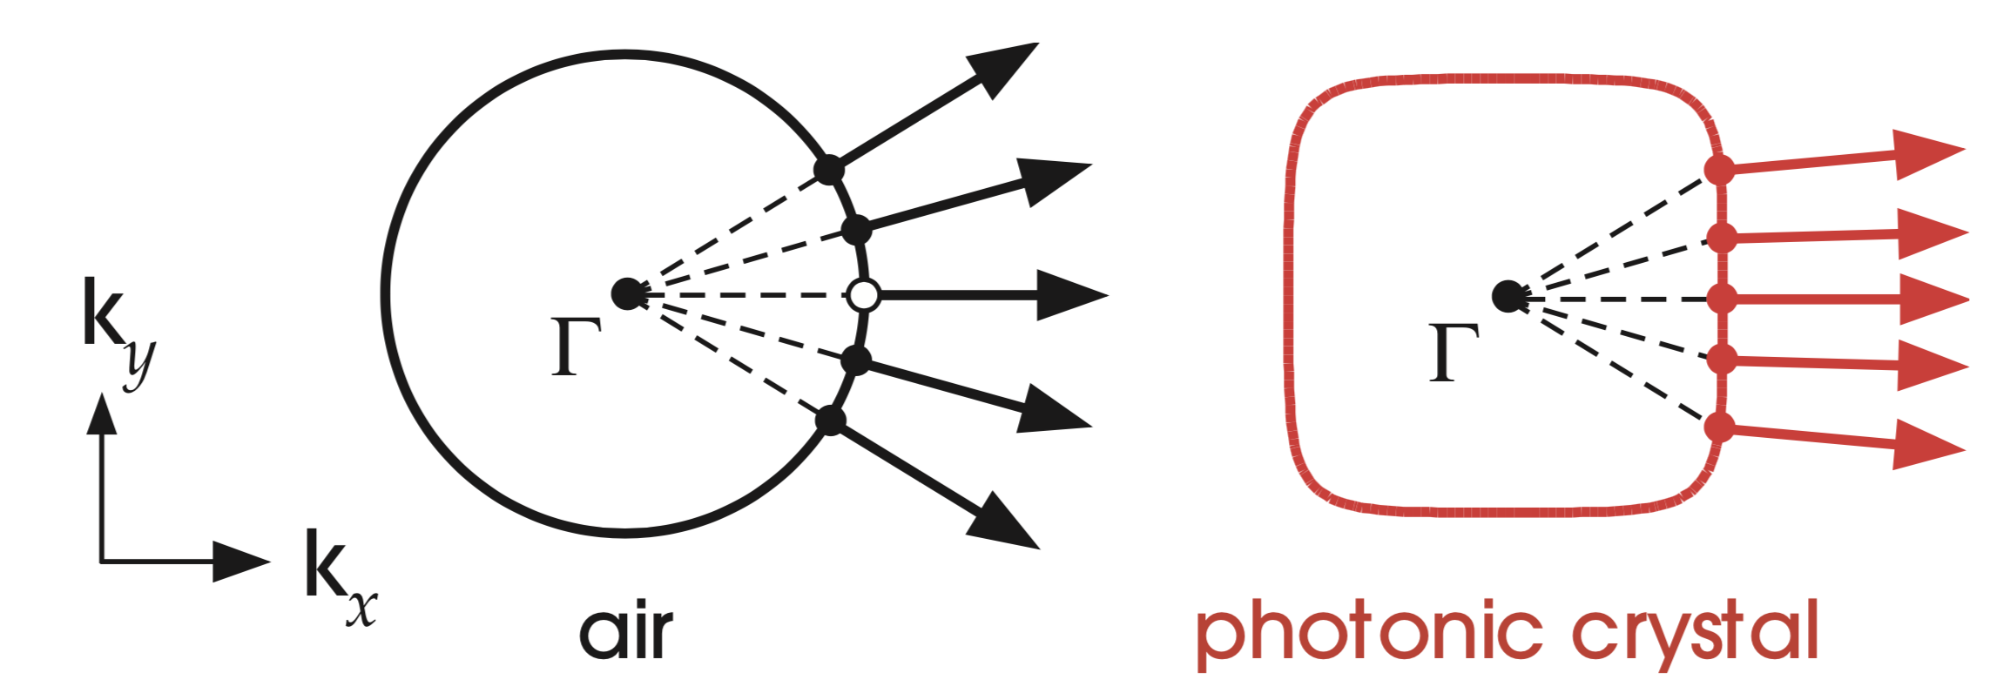
Supercollimation
A Gaussian (etc.) beam propagating in the x direction consists of many k_{y} components at the same ω. In a homogeneous medium, each k_{y} component travels in a different direction (group velocity). The beam therefore spreads (diffracts).
In a photonic crystal, the ω contour can be very “flat” so beam spreading is minimized: all the k_{y} components travel in almost the same direction. Supercollimation!

Slide 32
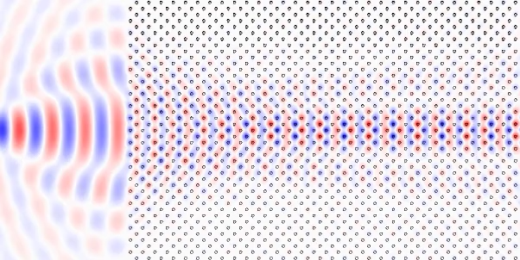
Supercollimation on the computer:
the light forms one or more coherent “Bloch beams”
that propagate without scattering
… and almost without diffraction (supercollimation)

Slide 33
Experimental supercollimation
Rakich et al., “Achieving centimetre-scale supercollimation in a large-area two-dimensional photonic crystal,” Nature Materials 5, 93–96 (2006).

Slide 34
Experimental supercollimation at λ≈1.5µm
Rakich et al., “Achieving centimetre-scale supercollimation in a large-area two-dimensional photonic crystal,” Nature Materials 5, 93–96 (2006).
Theory:
Experiment
(measured
vertical scattering
from disorder)
Theory, including
disorder:

